Slide 1
UNIT-II
NAMES ,BINDINGS AND SCOPES
DATA TYPES

Slide 2
.
What you will Learn:-
Fundamental semantic issues of variables
Describing the nature of names and special words in programming languages
The attributes of variables, including type, address, and value
The issue of aliases
Important concepts of binding and binding times
The different possible binding times for variable attributes and how they define four different categories of variables
Two very different scoping rules for names, static and dynamic
The concept of a referencing environment of a statement

Slide 3
Example for imperative language
  Start
  Turn on your shoes size 9 1/2.
  Make room in your pocket to keep an array[7] of keys.
  Put the keys in the room for the keys in the pocket.
  Enter garage.
  Open garage.
  Enter Car.
... and so on and on ...
  Put the milk in the refrigerator.
  Stop.

Slide 4
Example for Functional language
Milk is a healthy drink, unless you have problems digesting lactose.
Usually, one stores milk in a refrigerator.
A refrigerator is a box that keeps the things in it cool.
A store is a place where items are sold.
By "selling" we mean the exchange of things for money.
Also, the exchange of money for things is called "buying".
... and so on and on ...
Make sure we have milk in the refrigerator

Slide 5
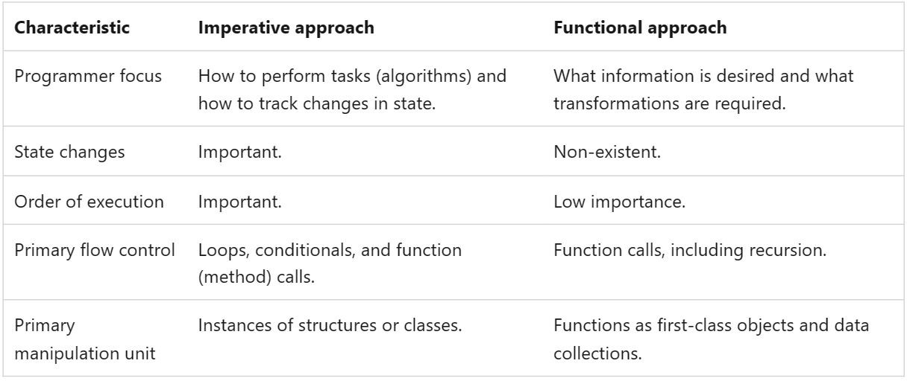
.

Slide 6
.
The architecture’s two primary components are its memory, which stores both instructions and data, and its processor, which provides operations for modifying the contents of the memory.
The abstractions in a language for the memory cells of the machine are variables.
A variable can be characterized by a collection of properties, or attributes, the most important of which is type, a fundamental concept in programming languages.
Designing the data types of a language requires that a variety of issues be considered.
Among the most important of these issues are the scope and lifetime of variables

Slide 7
.
Names
Names are identifiers that represent variables, functions, constants, types, and operations. They can also represent abstractions of a program fragment, such as a class or method.
Bindings
A binding is the association between a name and the thing it names. Bindings can occur at different times, such as during language design, implementation, or runtime.
Scopes
A scope is a section of a program where no bindings change, or at least no re-declarations are allowed.

Slide 8
.
Functional programming languages allow expressions to be named.
These named expressions appear like assignments to variable names in imperative languages, but are fundamentally different in that they cannot be changed.
They are like the named constants of the imperative languages.
Pure functional languages do not have variables that are like those of the imperative languages. However, many functional languages do include such variables.

Slide 9
.
Names
A name is a string of characters used to identify some entity in a program .
The earliest programming languages used single-character names.
This notation was natural because early programming was primarily mathematical, and mathematicians have long used single-character names for unknowns in their formal notations.
Fortran I broke with the tradition of the single-character name, allowing up to six characters in its names.

Slide 10
.
Fortran 95+ allows up to 31 characters in its names.
C99 has no length limitation on its internal names
Names in Java, C#, and Ada have no length limit, and all characters in them are significant.
C++ does not specify a length limit on names, although implementers sometimes do.
Names in most programming languages have the same form: a letter followed by a string consisting of letters, digits, and underscore characters ( _ ).
Although the use of underscore characters to form names was widely used in the 1970s and 1980s, that practice is now far less popular.
In the C-based languages, it has to a large extent been replaced by the so-called camel notation, in which all of the words of a multiple-word name except the first are capitalized, as in myStack
All variable names in PHP must begin with a dollar sign.

Slide 11
.
Perl, the special character at the beginning of a variable’s name, $, @, or %,
specifies its type
In Ruby, special characters at the beginning of a variable’s name, @ or @@, indicate that the variable is an instance or a class variable, respectively
C-based languages, uppercase and lowercase letters in names are distinct; that is, names in these languages are case sensitive.
For example, the following three names are distinct in C++: rose, ROSE, and Rose.

Slide 12
.
In Java and C#, the problem cannot be escaped because many of the predefined names include both uppercase and lowercase letters.
For example, the Java method for converting a string to an integer value is parseInt, and spellings such as ParseInt and parseint are not recognized.
This is a problem of writability rather than readability, because the need to remember specific case usage makes it more difficult to write correct programs.
It is a kind of intolerance on the part of the language designer, which is enforced by the compiler

Slide 13
.
    Special Words
    Special words in programming languages are used to make programs more readable by naming actions to be performed.
    They also are used to separate the syntactic parts of statements and programs.
    In most languages, special words are classified as reserved words, which means they cannot be redefined by programmers, but in some they are only keywords, which means they can be redefined.
    A keyword is a word of a programming language that is special only in certain contexts.

Slide 14
.
Fortran is the only remaining widely used language whose special words are keywords.
In Fortran, the word Integer, when found at the beginning of a statement and followed by a name, is considered a keyword that indicates the statement is a declarative statement. However, if the word Integer is followed by the assignment operator, it is considered a variable name.
These two uses are illustrated in the following:
Integer Apple Integer = 4
A reserved word is a special word of a programming language that cannot be used as a name.
As a language design choice, reserved words are better than keywords
because the ability to redefine keywords can be confusing.

Slide 15
.
For example, in Fortran, one could have the following statements:
Integer Real
Real Integer
There is one potential problem with reserved words: If the language includes a large number of reserved words, the user may have difficulty making up names that are not reserved.
The best example of this is COBOL, which has 300 reserved words.
Unfortunately, some of the most commonly chosen names by programmers are in the list of reserved words—for example, LENGTH, BOTTOM, DESTINATION, and COUNT.
In program code examples in this book, reserved words are presented in boldface

Slide 16
.
  Variables
  A variable is an abstraction of a memory cell.
  Variables can be characterized as a sextuple of attributes: (name, address, value, type, lifetime, and scope)
Name - Variable names are the most common names in programs
Address - the memory address with which it is associated (also called l-value)
– A variable may have different addresses at different times during execution
A variable may have different addresses at different places in a program
If two variable names can be used to access the same memory location, they are called aliases

Slide 17
.
Aliases are harmful to readability (program readers must remember all of them)
Type - determines the range of values of variables and the set of operations that are defined for values of that type; in the case of floating point, type also determines the Precision
Value - the contents of the location with which the variable is associated.
Abstract memory cell - the physical cell or collection of cells associated with a variable
The address of a variable is sometimes called its l-value, A variable’s value is sometimes called its r-value
Aliases - Example if variables named total and sum are aliases, any change to the value of total also changes the value of sum and vice versa. A reader of the program must always remember that total and sum are different names for the same memory cell.

Slide 18
.
  Binding
A binding is an association between an attribute and an entity, such as between a variable and its type or value, or between an operation and a symbol.
The time at which a binding takes place is called binding time
Binding and binding times are prominent concepts in the semantics of programming languages.
Bindings can take place at language design time, language implementation time, compile time, load time, link time, or run time.
For example, the asterisk symbol (*) is usually bound to the multiplication operation at language design time.
A data type, such as int in C, is bound to a range of possible values at language implementation time.
At compile time, a variable in a Java program is bound to a particular data type.

Slide 19
.
A variable may be bound to a storage cell when the program is loaded into memory.
That same binding does not happen until run time in some cases, as with variables declared in Java methods.
A call to a library subprogram is bound to the subprogram code at link time.
Consider the following Java assignment statement:
count = count + 5;
Some of the bindings and their binding times for the parts of this assignment statement are as follows:
The type of count is bound at compile time.
The set of possible values of count is bound at compiler design time.

Slide 20
.
The meaning of the operator symbol + is bound at compile time, when the types of its operands have been determined.
The internal representation of the literal 5 is bound at compiler design time.
The value of count is bound at execution time with this statement.
A complete understanding of the binding times for the attributes of program entities is a prerequisite for understanding the semantics of a programming language.
For example, to understand what a subprogram does, one must understand how the actual parameters in a call are bound to the formal parameters in its definition.
To determine the current value of a variable, it may be necessary to know when the variable was bound to storage and with which statement or statements

Slide 21
.
Types of Binding
There are two types of bindings
Static binding
Dynamic binding
A binding is static if it first occurs before run time begins and remains unchanged throughout program execution.
If the binding first occurs during run time or can change in the course of program execution, it is called dynamic.
    Type Bindings
Before a variable can be referenced in a program, it must be bound to a data type.
The two important aspects of this binding are how the type is specified and when the binding takes place.
Types can be specified statically through some form of explicit or implicit declaration.

Slide 22
.
An explicit declaration is a statement in a program that lists variable names and specifies that they are a particular type.
An implicit declaration is a means of associating variables with types through default conventions, rather than declaration statements.
      Static Type Binding
Consider the following declarations:
var sum = 0; var total = 0.0;
var name = "Fred";
The types of sum, total, and name are int, float, and string, respectively.
Keep in mind that these are statically typed variables - their types are fixed for the lifetime of the unit in which they are declared.

Slide 23
.
      Dynamic Type Binding
In Python, Ruby, JavaScript, and PHP, type binding is dynamic.
For example, a JavaScript script may contain the following statement:
list = [10.2, 3.5];
If the statement
list = 47;
    Storage Bindings and Lifetime
The memory cell to which a variable is bound somehow must be taken from a pool of available memory. This process is called allocation.
Deallocation is the process of placing a memory cell that has been unbound from a variable back into the pool of available memory
The lifetime of a variable is the time during which the variable is bound to a specific memory location.

Slide 24
.
Categories of variables
These categories are named, according to their lifetimes
static,
stack-dynamic,
explicit heap-dynamic, and
implicit heap-dynamic.
      Static Variables
A static variable is one that is bound to a memory cell before program execution begins and remains bound to that same memory cell until program execution terminates.
One advantage of static variables is efficiency.
One disadvantage of static binding to storage is reduced flexibility

Slide 25
.
      Stack-Dynamic Variables
      Stack-dynamic variables are those whose storage bindings are created when their declaration statements are elaborated, but whose types are statically bound.
      Elaboration of such a declaration refers to the storage allocation and binding process indicated by the declaration, which takes place when execution reaches the code to which the declaration is attached. Therefore, elaboration occurs during run time.
      Explicit Heap-Dynamic Variables
      Explicit heap-dynamic variables are nameless (abstract) memory cells that are allocated and deallocated by explicit run-time instructions written by the programmer.

Slide 26
.
These variables, which are allocated from and deallocated to the heap, can only be referenced through pointer or reference variables.
. An explicit heap-dynamic variable is created by either an operator (for example, in C++) or a call to a system subprogram provided for that purpose (for example, in C).
Explicit heap-dynamic variables are often used to construct dynamic structures, such as linked lists and trees, that need to grow and/or shrink during execution. Such structures can be built conveniently using pointers or references and explicit heap-dynamic variables.
The disadvantages of explicit heap-dynamic variables are the difficulty of using pointer and reference variables correctly, the cost of references to the variables, and the complexity of the required storage management implementation.

Slide 27
.
      Implicit Heap-Dynamic Variables
Implicit heap-dynamic variables are bound to heap storage only when they are assigned values. In fact, all their attributes are bound every time they are assigned.
For example, consider the following JavaScript assignment statement:
highs = [74, 84, 86, 90, 71];
Regardless of whether the variable named highs was previously used in the program or what it was used for, it is now an array of five numeric values.
The advantage of such variables is that they have the highest degree of flexibility, allowing highly generic code to be written.
One disadvantage of implicit heap-dynamic variables is the run-time overhead of maintaining all the dynamic attributes, which could include array subscript types and ranges, among others

Slide 28
.
Scope
A scope is a section of a program where no bindings change, or
at least no re-declarations are allowed.
scope of a variable
One of the important factors in understanding variables is scope.
The scope of a variable is the range of statements in which the variable is visible.
A variable is visible in a statement if it can be referenced or assigned in that statement.
The scope rules of a language determine how a particular occurrence of a name is associated with a variable, or in the case of a functional language, how a name is associated with an expression.

Slide 29
.
A clear understanding of these rules for a language is therefore essential to the ability to write or read programs in that language.
A variable is local in a program unit or block if it is declared there.
The nonlocal variables of a program unit or block are those that are visible within the program unit or block but are not declared there.
Global variables are a special category of nonlocal variables.
The lifetime of that variable is the period of time beginning when the method is entered and ending when execution of the method terminates.
The referencing environment of a statement is the collection of all variables that are visible in the statement.

Slide 30
.
A named constant is a variable that is bound to a value only once.
Named constants are useful as aids to readability and program reliability.
Readability can be improved
for example, by using the name pi instead of the constant 3.14159265. Another important use of named constants is to parameterize a program
Static Scope
Static scoping is so named because the scope of a variable can be statically determined—that is, prior to execution. This permits a human program reader (and a compiler) to determine the type of every variable in the program simply by examining its source code.

Slide 31
.
Static scoping is sometimes called lexical scoping.
Consider the following JavaScript function, big, in which the two functions
sub1 and sub2 are nested:
function big() {
function sub1() { var x = 7; sub2();
}
function sub2() {
var y = x;
}
var x = 3; sub1();
}
Under static scoping, the reference to the variable x in sub2 is to the x declared in the procedure big. This is true because the search for x begins in the procedure in which the reference occurs, sub2, but no declaration for x is found there. The search continues in the static parent of sub2, big, where the declaration of x is found

Slide 32
.
    Global Scope
Some languages, including C, C++, PHP, JavaScript, and Python, allow a program structure that is a sequence of function definitions, in which variable definitions can appear outside the functions. Definitions outside functions in a file create global variables, which potentially can be visible to those functions.
A global variable that is defined after a function can be made visible in the function by declaring it to be external, as in the following:
Extern int sum;

Slide 33
.
Consider the following example:
$day = "Monday";
$month = "January";
function calendar() {
$day = "Tuesday";
global $month;
print "local day is $day ";
$gday = $GLOBALS['day'];
print "global day is $gday <br \>";
print "global month is $month ";
}
calendar();
Interpretation of this code produces the following:
local day is Tuesday
global day is Monday
global month is January

Slide 34
.
    Dynamic Scope
Dynamic scoping is based on the calling sequence of subprograms, not on their spatial relationship to each other. Thus, the scope can be determined only at run time.
function big() {
function sub1() {
var x = 7;
}
function sub2() {
var y = x;
var z = 3;
}
var x = 3;
}

Slide 35
.
  Referencing Environments
The referencing environment of a statement is the collection of all variables that are visible in the statement.
The referencing environment of a statement in a static-scoped language is the variables declared in its local scope plus the collection of all variables of its ancestor scopes that are visible.
In such a language, the referencing environment of a statement is needed while that statement is being compiled, so code and data structures can be created to allow references to variables from other scopes during run time.
Consider the following Python skeletal program:

Slide 36
.
g = 3; # A global
def sub1():
a = 5; # Creates a local
b = 7; # Creates another local.
. . . . . . . . . . 1
def sub2():
global g; # Global g is now assignable here c = 9; # Creates a new local
. . . . . . . .. . < 2
def sub3():
nonlocal c: # Makes nonlocal c visible here g = 11; # Creates a new local
. . . . . . . . . . . . < 3

Slide 37
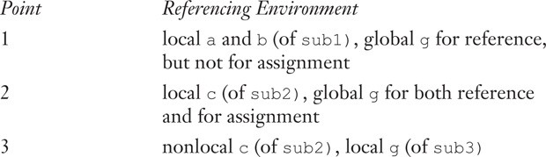
.
The referencing environments of the indicated program points are as follows

Slide 38
.
  Named Constants
A named constant is a variable that is bound to a value only once.
Named constants are useful as aids to readability and program reliability. Readability can be improved, for example, using the name pi instead of the constant 3.14159265.
Another important use of named constants is to parameterize a program. For example, consider a program that processes a fixed number of data values, say 100. Such a program usually uses the constant 100 in a number of locations for declaring array subscript ranges and for loop control limits.
Consider the following skeletal Java program segment:

Slide 39
.
void example() {
int[] intList = new int[100]; String[] strList = new String[100];
. . .
for (index = 0; index < 100; index++) {
. . .
}
. . .
for (index = 0; index < 100; index++) {
. . .
}
. . .
average = sum / 100;
. . .
}

Slide 40
.
Data Types
A data type defines a collection of data values and a set of predefined operations on those values.
There are a number of uses of the type system of a programming language. The most practical of these is error detection. The process and value of type checking, which is directed by the type system of the language.
A second use of a type system is the assistance it provides for program modularization. This results from the cross-module type checking that ensures the consistency of the interfaces among modules.
Another use of a type system is documentation. The type declarations in a program document information about its data

Slide 41
.
The two most common structured data types in the imperative languages are arrays and records, although the popularity of associative arrays has increased significantly in recent years.
Lists have been a central part of functional programming languages
Over the last decade, the increasing popularity of functional programming has led to lists being added to primarily imperative languages, such as Python and C#
The structured data types are defined with type operators, or constructors, which are used to form type expressions. For example, C uses brackets and asterisks as type operators to specify arrays and pointers.

Slide 42
.
A descriptor is the collection of the attributes of a variable
In an implementation, a descriptor is an area of memory that stores the attributes of a variable.
If the attributes are all static, descriptors are required only at compile time.
For dynamic attributes, however, part or all of the descriptor must be maintained during execution.
In all cases, descriptors are used for type checking and building the code for the allocation and deallocation operations.

Slide 43
.
The word object is often associated with the value of a variable and the space it occupies
object exclusively for instances of user-defined and language-defined abstract data types, rather than for the values of all program variables of predefined types.
One design issue is fundamental to all data types: What operations are provided for variables of the type, and how are they specified?
  Primitive Data Types
Data types that are not defined in terms of other types are called primitive data types.
Nearly all programming languages provide a set of primitive data types. Some of the primitive types are merely reflections of the hardware

Slide 44
.
To specify the structured types, the primitive data types of a language are used, along with one or more type constructors.
  Primitive Data Types
  Data types that are not defined in terms of other type are called primitive data types
Some primitive data types are merely reflections of the hardware
Others require only a little non-hardware support for their implementation
Almost all programming languages provide a set of primitive data types

Slide 45
.
Integer
Floating Point
Complex
Decimal
Boolean Types
Character Types
Integer
The most common primitive numeric data type is integer. Many computers now support several sizes of integers. Example: Java includes four signed integer sizes:
byte, short, int, and long
Example, C++ and C#, include unsigned integer types, which are simply types for integer values without signs

Slide 46
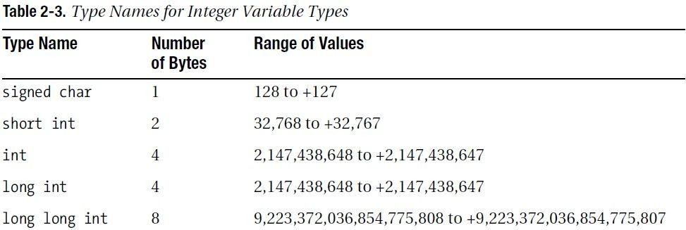
.

Slide 47
.
Floating Point
Languages for scientific use support at least two floating-point types (e.g., float and double)
Newer Machine Uses IEEE Floating-Point Standard 754
The float type is the standard size, usually being stored in four bytes of memory.
The double type is provided for situations where larger fractional parts and/or a larger range of exponents is needed
The collection of values that can be represented by a floating-point type is defined in terms of precision and range.
Precision is the accuracy of the fractional part of a value, measured as the number of bits.
Range is a combination of the range of fractions and, more important, the range of exponents
0.1 in decimal is 0.0001100110011 in binary

Slide 48
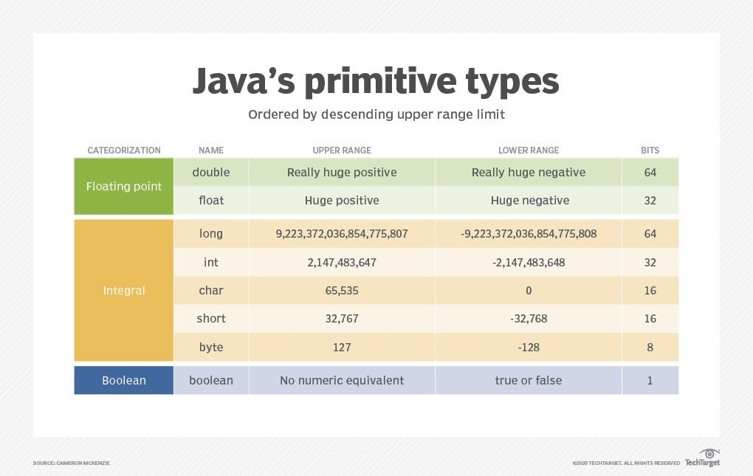
.

Slide 49
.
complex type
Some languages support a complex type, e.g., Fortran and Python
Each value consists of two floats, the real part and the
imaginary part
Literal form (in Python): (7 + 3j),
where 7 is the real part and 3 is the imaginary part

Slide 50
.
Decimal type
For business applications (money) Essential to COBOL
Decimal types are stored very much like character strings, using binary codes for the decimal digits.
These representations are called Binary Coded Decimal (BCD) Advantage: accuracy
Disadvantages: limited range, wastes memory

Slide 51
.
Boolean
Simplest of all
Range of values: two elements, one for true and one for false
Could be implemented as bits, but often as bytes
Boolean types are often used to represent switches or flags in programs.
Advantage: readability

Slide 52
.
Character
Stored as numeric codings
Most commonly used coding: ASCII
An alternative, 16-bit coding: Unicode Includes characters from most natural languages
Originally used in Java
C# and JavaScript also support Unicode

Slide 53
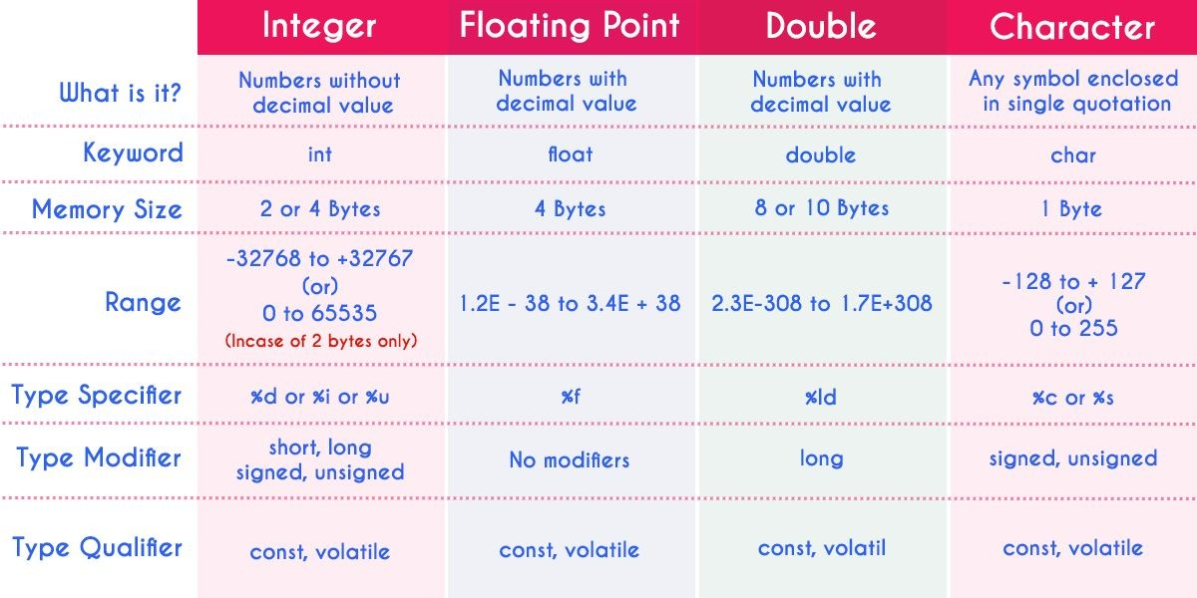
.

Slide 54
.
Character String Types
A character string type is one in which the values consist of sequences of characters.
Character string constants are used to label output, and the input and output of all kinds of data are often done in terms of strings.
Character String Types Operations
Typical operations:
Assignment and copying
Comparison (=, >, etc.)
Catenation
Substring reference
Pattern matching

Slide 55
.
Character String Type in Certain Languages
C & C++ Not primitive, Use char arrays and a library of functions that provide operations
SNOBOL4 (a string manipulation language) Primitive, Many operations, including elaborate pattern matching
Fortran and Python Primitive type with assignment and several operations
Java Primitive via the String class
Perl, JavaScript, Ruby, and PHP Provide built-in pattern matching, using regular expressions

Slide 56
.
User-Defined Ordinal Types
An ordinal type is one in which the range of possible values can be easily associated with the set of positive integers.
In Java, for example, the primitive ordinal types are integer, char, and boolean.
There are two user-defined ordinal types that have been supported by programming languages: enumeration and subrange

Slide 57
.
Enumeration Type
An enumeration type is one in which all of the possible values, which are named constants, are provided, or enumerated, in the definition.
Enumeration types provide a way of defining and grouping collections of named constants, which are called enumeration constants.
The definition of a typical enumeration type is shown in the following C# example:
enum days {Mon, Tue, Wed, Thu, Fri, Sat, Sun}; Source:

Slide 58
.
Subrange Types
A subrange type is a contiguous subsequence of an ordinal type.
For example, 12..14 is a subrange of integer type.
Subrange types were introduced by Pascal and are included in Ada.
There are no design issues that are specific to subrange types
Array Types
An array is an aggregate of homogeneous data elements in which an individual element is identified by its position in the aggregate, relative to the first element

Slide 59
.
In many languages, such as C, C++, Java, Ada, and C#, all of the elements of an array are required to be of the same type.
In these languages, pointers and references are restricted to point to or reference a single type.
Array Design Issues
What types are legal for subscripts?
Are subscripting expressions in element references range checked?
When are subscript ranges bound?
When does allocation take place?
What is the maximum number of subscripts?
Can array objects be initialized?
Are any kind of slices supported

Slide 60
.
Associative Arrays
An associative array is an unordered collection of data elements that are indexed by an equal number of values called keys
User-defined keys must be stored
Design issues:
What is the form of references to elements?
Is the size static or dynamic?

Slide 61
.
Record Types
A record is an aggregate of data elements in which the individual elements are identified by names and accessed through offsets from the beginning of the structure.
Design issues:
What is the syntactic form of references to the field?
Are elliptical references

Slide 62
.
Union Types
A union is a type whose variables are allowed to store different type values at different times during execution
Design issues:
Should type checking be required?
Should unions be embedded in records?

Slide 63
.
Tuple Types
A tuple is a data type that is similar to a record, except that the elements are not named.
Python’s tuples are closely related to its lists, except that tuples are immutable.
A tuple is created by assigning a tuple literal.
Example: myTuple = (3, 5.8, ‘apple’)
The elements of a tuple need not be of the same type
The elements of a tuple can be referenced with indexing in brackets
Example: myTuple[1]
This references the first element of the tuple, because tuple indexing begins at 1.

Slide 64
.
Tuples can be catenated with the plus (+) operator.
They can be deleted with the del statement
Example: val myTuple = (3, 5.8, ‘apple’);
The syntax of a tuple element access is a follows:
#1 (myTuple); This reference the first element of the tuple
Example: let tup = (3, 5, 7);; let a, b, c = tup;; This assigns 3 to a, 5 to b, and 7 to c
List Types
Lists were first supported in the first functional programming language, LISP.
They have always been part of the functional languages, but in recent years they have found their way into some imperative languages.

Slide 65
.
Lists in Scheme and Common LISP are delimited by parentheses and the elements are not separated by any punctuation.
Example List Nested List
(A B C D)
(A (B C) D)
The fundamental list operations in Scheme are two functions that take lists apart and two that build lists
CAR function returns the first element of its list parameter.
Example (CAR ‘(A B C))
The quote before the parameter list is to prevent the interpreter from considering the list a call to the A function with the parameters B and C, in which case it would interpret it. This call to CAR returns A
Example (CDR ‘(A B C))

Slide 66
.
The CDR function returns its parameter list minus its first element
The function call returns the list (B C) List Types
Example (CONS ‘A ‘(B C))
This call returns the new list (A B C)
Example (LIST ‘A ‘B ‘(C D))
This call returns the new list (A B (C D))
Example 3 :: [5, 7, 9]
This returns the new list: [3, 5, 7, 9]
Example [5, 7.3, 9]
The elements of a list must be of the same type, the above list is illegal List Types
Example other functions hd(head), tl(tail) hd [5, 7, 9] is 5 tl [5, 7, 9] is [7, 9]
Example myList = [3, 5.8, “grape”] x = myList[1]

Slide 67
.
This statement assigns 5.8 to x. The elements of a list are indexed starting at zero.
List elements also can be updated by assignment.
A list element can be deleted with del.
Example del myList[1]
This statement removes the second element of myList

Slide 68
.
Pointer and Reference Types
A pointer type is one in which the variables have a range of values that consists of memory addresses and a special value, nil.
Pointers are designed for two distinct kinds of uses.
First, pointers provide some of the power of indirect addressing, which is frequently used in assembly language programming.
Second, pointers provide a way to manage dynamic storage. A pointer can be used to access a location in an area where storage is dynamically allocated called a heap.
They often do not have identifiers associated with them and thus can be referenced only by pointer or reference type variables. Variables without names are called anonymous variables

Slide 69
.
Pointers, unlike arrays and records, are not structured types, although they are defined using a type operator (* in C and C++ and access in Ada).
Variables that are dynamically allocated from the heap are called heap dynamic variables
Design Issues with Pointers
The primary design issues particular to pointers are the following:
What are the scope and lifetime of a pointer variable?
What is the lifetime of a heap-dynamic variable (the value a pointer references)?
Are pointers restricted as to the type of value to which they can point?
Are pointers used for dynamic storage management, indirect addressing, or both?
Should the language support pointer types, reference types, or both

Slide 70
.
Reference Type
A reference type variable is similar to a pointer, with one important and fundamental difference: A pointer refers to an address in memory, while a reference refers to an object or a value in memory.
As a result, although it is natural to perform arithmetic on addresses, it is not sensible to do arithmetic on references
Type Checking
Type checking is the activity of ensuring that the operands of an operator are of compatible types.
A compatible type is one that either is legal for the operator or is allowed under language rules to be implicitly converted by compiler-generated code (or the interpreter) to a legal type.

Slide 71
.
This automatic conversion is called a coercion.
A type error is the application of an operator to an operand of an inappropriate type.
Dynamic type binding requires type checking at run time, which is called dynamic type checking.
If all bindings of variables to types are static in a language, then type checking can nearly always be done statically.
  Strong Typing
  One of the ideas in language design that became prominent in the so-called structured-programming revolution of the 1970s was strong typing.
  Strong typing is widely acknowledged as being a highly valuable language characteristic

Slide 72
.
A programming language is strongly typed if type errors are always detected. This requires that the types of all operands can be determined, either at compile time or at run time.
The importance of strong typing lies in its ability to detect all misuses of variables that result in type errors.
Type Equivalence
The idea of type compatibility was defined when the issue of type checking was introduced.
: Name type compatibility means the two variables have compatible types if they are in either the same declaration or in declarations that use the same type name
The compatibility rules dictate the types of operands that are acceptable for each of the operators and thereby specify the possible type errors of the language.
The rules are called compatibility because in some cases the type of an operand can be implicitly converted by the compiler or run-time system to make it acceptable to the operator

Slide 73
.
Expressions
Expressions are the fundamental means of specifying computations in a programming language.
It is crucial for a programmer to understand both the syntax and semantics of expressions of the language being used.
To understand expression evaluation, it is necessary to be familiar with the orders of operator and operand evaluation.
The operator evaluation order of expressions is dictated by the associativity and precedence rules of the language.
To understand expression evaluation, need to be familiar with the orders of operator and operand evaluation

Slide 74
.
  Arithmetic Expressions
Automatic evaluation of arithmetic expressions similar to those found in mathematics, science, and engineering was one of the primary goals of the first high-level programming languages
In programming languages, arithmetic expressions consist of operators, operands, parentheses, and function calls.
An operator can be unary, meaning it has a single operand, binary, meaning it has two operands, or ternary, meaning it has three operands
Example: result=a+b*c
In this result is variable store the expression value
a,b,c are operand1,operand2 &operand3
+,* are operator1 and operator2

Slide 75
.
Primary Design Issues for Arithmetic Expressions
What are the operator precedence rules?
What are the operator associativity rules?
What is the order of operand evaluation?
Are there restrictions on operand evaluation side effects?
Does the language allow user-defined operator overloading?
What type mixing is allowed in expressions?

Slide 76
.
Operator Precedence Rules
The value of an expression depends at least in part on the order of evaluation of the operators in the expression.
Consider the following expression:
a + b * c
Suppose the variables a, b, and c have the values 3, 4, and 5, respectively. If evaluated left to right (the addition first and then the multiplication), the result is 35.
If evaluated right to left, the result is 23.
The operator precedence rules for expression evaluation partially define the order in which the operators of different precedence levels are evaluated
The operator precedence rules of the common imperative languages are nearly all the same, because they are based on those of mathematics

Slide 77
.
In these languages, exponentiation has the highest precedence (when it is provided by the language), followed by multiplication and division on the same level, followed by binary addition and subtraction on the same level.
Example
In all of the common imperative languages, the unary minus operator can appear in an expression either at the beginning or anywhere inside the expression, as long as it is parenthesized to prevent it from being next to another operator.
For example,
a + (- b) * c is legal,
but a + - b * c usually is not.

Slide 78
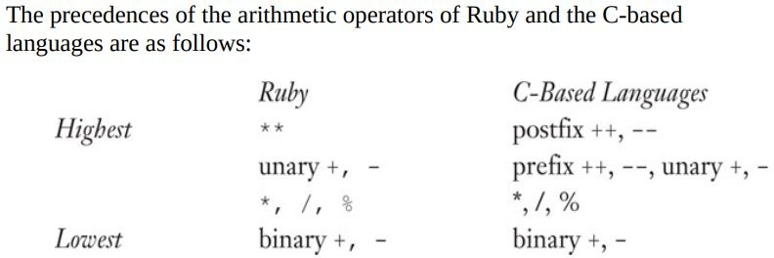
.

Slide 79
.
Associativity
The precedence rules say nothing about the order of evaluation of the operators
When an expression contains two adjacent 2 occurrences of operators with the same level of precedence, the question of which operator is evaluated first is answered by the associativity rules of the language.
An operator can have either left or right associativity, meaning that when there are two adjacent operators with the same precedence, the left operator is evaluated first or the right operator is evaluated first, respectively.
Consider the following expression:
a - b + c - d
If the addition and subtraction operators have the same level of precedence, as they do in programming languages, the precedence rules say nothing about the order of evaluation of the operators in this expression.

Slide 80
.
Associativity in common languages is left to right, except that the exponentiation operator (when provided) sometimes associates right to left
In the Java expression
a - b + c
the left operator is evaluated first.
Exponentiation in Fortran and Ruby is right associative, so in the expression
A ** B ** C
the right operator is evaluated first.
In Visual Basic, the exponentiation operator, ^, is left associative.

Slide 81
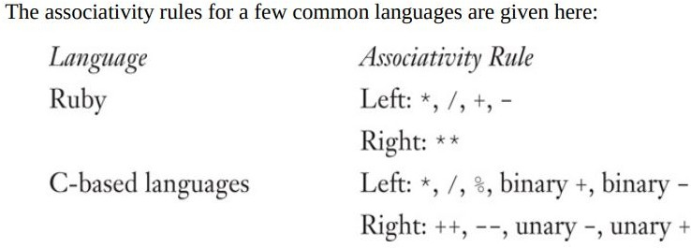
.

Slide 82
.
In APL, all operators have the same level of precedence. Thus, the order of evaluation of operators in APL expressions is determined entirely by the associativity rule, which is right to left for all operators.
For example, in the expression A × B + C
the addition operator is evaluated first, followed by the multiplication operator (× is the APL multiplication operator).
If A were 3, B were 4, and C were 5, then the value of this APL expression would be 27.
Parentheses
Programmers can alter the precedence and associativity rules by placing parentheses in expressions.
A parenthesized part of an expression has precedence over its adjacent unparenthesized parts.

Slide 83
.
For example, although multiplication has precedence over addition, in the expression
(A + B) * C
the addition will be evaluated first.
Ruby Expressions
Ruby is a pure object-oriented language, which means, among other things, that every data value, including literals, is an object.
Ruby supports the collection of arithmetic and logic operations that are included in the C-based languages.
What sets Ruby apart from the C-based languages in the area of expressions is that all of the arithmetic, relational, and assignment operators, as well as array indexing, shifts, and bitwise logic operators, are implemented as methods.
For example, the expression a + b is a call to the + method of the object referenced by a, passing the object referenced by b as a parameter.

Slide 84
.
Expressions in Lisp
As is the case with Ruby, all arithmetic and logic operations in Lisp are performed by subprograms.
But in Lisp, the subprograms must be explicitly called.
For example, to specify the C expression a + b * c in Lisp, one must write the following expression.
When a list is interpreted as code in Lisp, the first element is the function name and others are parameters to the function.
(+ a (* b c))
In this expression, + and * are the names of functions.

Slide 85
.
Conditional expression
if-then-else statements can be used to perform a conditional expression assignment.
For example, consider
if (count == 0)
average = 0;
else
average = sum / count;
In the C-based languages, this code can be specified more conveniently in an assignment statement using a conditional expression, which has the following form:
expression_1 ? expression_2 : expression_3

Slide 86
.
Where expression_1 is interpreted as a Boolean expression.
If expression_1 evaluates to true, the value of the whole expression is the value of expression_2; otherwise, it is the value of expression_3.
For example, the effect of the example if-then-else can be achieved with the following assignment statement, using a conditional expression:
average = (count == 0) ? 0 : sum / count;
Operand Evaluation order
A less commonly discussed design characteristic of expressions is the order of evaluation of operands.
Variables in expressions are evaluated by fetching their values from memory.

Slide 87
.
Constants are sometimes evaluated the same way.
In other cases, a constant may be part of the machine language instruction and not require a memory fetch.
If an operand is a parenthesized expression, all of the operators it contains must be evaluated before its value can be used as an operand.
Side effects
A side effect of a function, naturally called a functional side effect, occurs when the function changes either one of its parameters or a global variable.
Consider the following expression:
a + fun(a)

Slide 88
.
If fun does not have the side effect of changing a, then the order of evaluation of the two operands, a and fun(a), has no effect on the value of the expression. However, if fun changes a, there is an effect
Consider the following situation: fun returns 10 and changes the value of its parameter to 20.
Suppose we have the following:
a = 10;
b = a + fun(a);
Then, if the value of a is fetched first (in the expression evaluation process), its value is 10 and the value of the expression is 20. But if the second operand is evaluated first, then the value of the first operand is 20 and the value of the expression is 30.

Slide 89
.
The following C program illustrates the same problem when a function changes a global variable that appears in an expression:
int a = 5; int fun1() {
a = 17;
return 3;
} /* end of fun1 */ void main() {
a = a + fun1();
}
The value computed for a in main depends on the order of evaluation of the operands in the expression a + fun1(). The value of a will be either 8 (if a is evaluated first) or 20 (if the function call is evaluated first).

Slide 90
.
Overloaded Operators
Arithmetic operators are often used for more than one purpose.
For example, + usually is used to specify integer addition and floating-point addition.
Some languages: Java, for example - also use it for string catenation.
This multiple use of an operator is called operator overloading and is generally thought to be acceptable, as long as neither readability nor reliability suffers.

Slide 91
.
Type Conversions
Type conversions are either narrowing or widening.
A narrowing conversion converts a value to a type that cannot store even approximations of all of the values of the original type.
For example, converting a double to a float in Java is a narrowing conversion, because the range of double is much larger than that of float.
A widening conversion converts a value to a type that can include at least approximations of all of the values of the original type.
For example, converting an int to a float in Java is a widening conversion

Slide 92
.
Relational expressions
A relational operator is an operator that compares the values of its two operands.
A relational expression has two operands and one relational operator.
The value of a relational expression is Boolean, except when Boolean is not a type included in the language.
The relational operators are often overloaded for a variety of types.
The operation that determines the truth or falsehood of a relational expression depends on the operand types.
It can be simple, as for integer operands, or complex, as for character string operands.

Slide 93
.
Typically, the types of the operands that can be used for relational operators are numeric types, strings, and enumeration types.
The relational operators always have lower precedence than the arithmetic operators, so that in expressions such as
a + 1 > 2 * b
the arithmetic expressions are evaluated first.
Boolean Expressions
Boolean expressions consist of Boolean variables, Boolean constants, relational expressions, and Boolean operators.
The operators usually include those for the AND, OR, and NOT
operations, and sometimes for exclusive OR and equivalence.

Slide 94
.
Short-circuit evaluation
A short-circuit evaluation of an expression is one in which the result is determined without evaluating all of the operands and/or operators.
For example, the value of the arithmetic expression (13 * a) * (b / 13 - 1)
is independent of the value of (b / 13 - 1) if a is 0, because 0 * x = 0 for any x. So, when a is 0, there is no need to evaluate (b / 13 - 1) or perform the second multiplication. However, in arithmetic expressions, this shortcut is not easily detected during execution, so it is never taken.
The value of the Boolean expression
(a >= 0) && (b < 10)

Slide 95
.
is independent of the second relational expression if a < 0, because the expression (FALSE && (b < 10)) is FALSE for all values of b.
So, when a is less than zero, there is no need to evaluate b, the constant 10, the second relational expression, or the && operation.
Unlike the case of arithmetic expressions, this shortcut easily can be discovered during execution.
Assignment statements
Nearly all programming languages currently being used
use the equal sign for the assignment operator.

Slide 96
.
All of these must use something different from an equal sign for the equality relational operator to avoid confusion with their assignment operator.
Example:
B = A; // Assign operand A to the B
ALGOL 60 pioneered the use of := as the assignment operator, which avoids the confusion of assignment with equality.
Ada also uses this assignment operator.
The design choices of how assignments are used in a language have varied widely
In some languages, such as Fortran and Ada, an assignment can appear only as a stand-alone statement, and the destination is restricted to a single variable.

Slide 97
.
Assignment statement example
Conditional Targets
Perl allows conditional targets on assignment statements. For example,
($flag ? $count1 : $count2) = 0;
which is equivalent to if ($flag) {
$count1 = 0;
} else {
$count2 = 0;
}

Slide 98
.
Compound assignment operators
A compound assignment operator is a shorthand method of specifying a commonly needed form of assignment.
The form of assignment that can be abbreviated with this technique has the destination variable also appearing as the first operand in the expression on the right side, as in
a = a + b
Compound assignment operators were introduced by ALGOL 68, were later adopted in a slightly different form by C, and are part of the other C-based languages, as well as Perl, JavaScript, Python, and Ruby.
The syntax of these assignment operators is the catenation of the desired binary operator to the = operator

Slide 99
.
For example,
sum += value;
is equivalent to
sum = sum + value;
Unary Assignment Operators
The C-based languages, Perl, and JavaScript include two special unary arithmetic operators that are actually abbreviated assignments.
They combine increment and decrement operations with assignment.
The operators ++ for increment and -- for decrement can be used either in expressions or to form stand-alone single-operator assignment statements.
They can appear either as prefix operators, meaning that they precede the operands, or as postfix operators, meaning that they follow the operands.

Slide 100
.
Unary Assignment Operators Example
In the assignment statement
sum = ++ count;
the value of count is incremented by 1 and then assigned to sum. This operation could also be stated as
count = count + 1;
sum = count;
If the same operator is used as a postfix operator, as in
sum = count ++;
the assignment of the value of count to sum occurs first; then count is incremented. The effect is the same as that of the two statements
sum = count;
count = count + 1;

Slide 101
.
Multiple Assignments
Several recent programming languages, including Perl and Ruby provide multiple-target, multiple-source assignment statements.
For example, in Perl one can write
($first, $second, $third) = (20, 40, 60);
The semantics is that 20 is assigned to $first, 40 is assigned to
$second, and 60 is assigned to $third. If the values of two variables must be interchanged, this can be done with a single assignment, as with
($first, $second) = ($second, $first);

Slide 102
.
Mixed-Mode Assignment
Assignment statements also are mixed mode.
C, C++, and Perl use coercion rules for mixed-mode assignment that are similar to those they use for mixed-mode expressions
an int value can be assigned to a float variable, but not vice versa
If an integer literal, which the compiler by default assigns the type int, is assigned to a char, byte, or short variable and the literal is in the range of the type of the variable, the int value is coerced to the type of the variable in a narrowing conversion

Slide 103
.
Statement-Level Control Structures
some means of selecting among alternative control flow paths (of statement execution) and some means of causing the repeated execution of statements or sequences of statements. Statements that provide these kinds of capabilities are called control statements.
A control structure is a control statement and the collection of statements whose execution it controls.
The control statements of the first successful programming language, Fortran, were, in effect, designed by the architects of the IBM 704.

Slide 104
.
Selection Statements
A selection statement provides the means of choosing between two or more execution paths in a program. Such statements are fundamental and essential parts of all programming languages, as was proven by Böhm and Jacopini.
Selection statements fall into two general categories:
Two-way and
n-way, or multiple selection.
    Two-Way Selection Statements
Although the two-way selection statements of contemporary imperative languages are quite similar, there are some variations in their designs. The general form of a two-way selector is as follows:

Slide 105
.
If control_expression
then clause
else clause
      Design Issues
The design issues for two-way selectors can be summarized as follows:
What is the form and type of the expression that controls the selection? How are the then and else clauses specified?
How should the meaning of nested selectors be specified
The Control Expression
Control expressions are specified in parentheses if the then reserved word (or some other syntactic marker) is not used to introduce the then clause. In those cases where the then reserved word (or alternative marker) is used, there is less need for the parentheses, so they are often omitted, as in Ruby.

Slide 106
.
      Nesting Selectors
if (sum == 0) {
if (count == 0) { result = 0;
}
} else {
result = 1;
}
    Multiple-Selection Statements
The multiple-selection statement allows the selection of one of any number of statements or statement groups. It is, therefore, a generalization of a selector. In fact, two-way selectors can be built with a multiple selector

Slide 107
.
      Design Issues
The following is a summary of these design issues:
What is the form and type of the expression that controls the selection? How are the selectable segments specified?
Is execution flow through the structure restricted to include just a single selectable segment?
How are the case values specified?
How should unrepresented selector expression values be handled, if at all?

Slide 108
.
      Examples of Multiple Selectors
The C multiple-selector statement, switch, which is also part of C++, Java, and JavaScript, is a relatively primitive design. Its general form is
switch (expression) {
case constant_ expression1: statement1;
……. . .
case constantn: statement_n; [default: statementn+1]
}
where the control expression and the constant expressions are some discrete type. This includes integer types, as well as characters and enumeration types.

Slide 109
.
This includes integer types, as well as characters and enumeration types. The selectable statements can be statement sequences, compound statements, or blocks. The optional default segment is for unrepresented values of the control expression. If the value of the control expression is not represented and no default segment is present, then the statement does nothing.
The switch statement does not provide implicit branches at the end of its code segments. This allows control to flow through more than one selectable code segment on a single execution. Consider the following example:
switch (index) {
case 1:
case 3: odd += 1;
sumodd += index;

Slide 110
.
case 2:
case 4: even += 1;
sumeven += index;
default: printf("Error in switch, index = %d\n", index);
}
The following switch statement uses break to restrict each execution to a single selectable segment:
switch (index) {
case 1:
case 3: odd += 1;
sumodd += index;
break;
case 2:
case 4: even += 1;
sumeven += index;
break;
default: printf("Error in switch, index = %d\n", index);
}

Slide 111
.
Iterative Statements
An iterative statement is one that causes a statement or collection of statements to be executed zero, one, or more times.
An iterative statement is often called a loop.
Several categories of iteration control statements have been developed. The primary categories are defined by how designers answered two basic design questions:
How is the iteration controlled?
Where should the control mechanism appear in the loop statement?

Slide 112
.
The body of an iterative statement is the collection of statements whose execution is controlled by the iteration statement. We use the term pretest to mean that the test for loop completion occurs before the loop body is executed and posttest to mean that it occurs after the loop body is executed. The iteration statement and the associated loop body together form an iteration statement
Counter-Controlled Loops
A counting iterative control statement has a variable, called the loop variable, in which the count value is maintained. It also includes some means of specifying the initial and terminal values of the loop variable, and the difference between sequential loop variable values, often called the stepsize. The initial, terminal, and stepsize specifications of a loop are called the loop parameters.

Slide 113
.
Although logically controlled loops are more general than counter-controlled loops, they are not necessarily more commonly used. Because counter- controlled loops are more complex, their design is more demanding.
Design Issues
The following is a summary of these design issues:
What are the type and scope of the loop variable?
Should it be legal for the loop variable or loop parameters to be changed in the loop, and if so, does the change affect loop control?
Should the loop parameters be evaluated only once, or once for every iteration?
What is the value of the loop variable after loop termination?

Slide 114
.
for (expression_1; expression_2; expression_3)
loop body
The loop body can be a single statement, a compound statement, or a null statement.
expression_1
loop:
if expression_2 = 0 goto out
[loop body]
expression_3
goto loop
out: . . .

Slide 115
.
  Unconditional Branching
An unconditional branch statement transfers execution control to a specified location in the program.
The most heated debate in language design in the late 1960s was over the issue of whether unconditional branching should be part of any high-level language, and if so, whether its use should be restricted.
The unconditional branch, or goto, is the most powerful statement for controlling the flow of execution of a program’s statements.
The goto has stunning power and great flexibility (all other control structures can be built with goto and a selector), but it is this power that makes its use dangerous.
Without usage restrictions, imposed by either language design or programming standards, goto statements can make programs very difficult to read, and as a result, highly unreliable and costly to maintain.

Slide 116
.
  Guarded Commands
The motivation is the increased clarity in reasoning that is possible with guarded commands.
Simply put, a selectable segment of a selection statement in a guarded-command statement can be considered independently of any other part of the statement, which is not true for the selection statements of the common programming languages.
selection statement has the form
if <Boolean expression> -> <statement>
[] <Boolean expression> -> <statement>
[] . . .
[] <Boolean expression> -> <statement>
fi

Slide 117
.
The closing reserved word, fi, is the opening reserved word spelled backward.
This form of closing reserved word is taken from ALGOL 68. The small blocks, called fatbars, are used to separate the guarded clauses and allow the clauses to be statement sequences.
Each line in the selection statement, consisting of a Boolean expression (a guard) and a statement or statement sequence, is called a guarded command.
If more than one expression is true, one of the corresponding statements can be nondeterministically chosen for execution
An implementation might always choose the statement associated with the first Boolean expression that evaluates to be true. But it may choose any statement associated with a true Boolean expression. So, the correctness of the program cannot depend on which statement is chosen (among those associated with true Boolean expressions). If none of the Boolean expressions are true, a run-time error occurs that causes program termination. This forces the programmer to consider and list all possibilities

Slide 118
.
Consider the following example:
if i = 0 -> sum := sum + i
[] i > j -> sum := sum + j
[] j > i -> sum := sum + k
fi
If i = 0 and j > i, this statement chooses nondeterministically between the first and third assignment statements. If i is equal to j and is not zero, a run- time error occurs because none of the conditions are true.

